Slide 1

CSE2PM09A / AID2PM07A
Design and Analysis of Algorithm
DEPARTMENT OF COMPUTER ENGINEERING AND TECHNOLOGY

Slide 2

Syllabus
Unit I: Introductions to Algorithms:Analysis of Algorithm: Efficiency- Analysis framework, asymptotic notations – big O, theta and omega. Analysis of Non-recursive and recursive algorithms: Solving Recurrence Equations using Masters theorem and Substitution method. Searching: Search Techniques-Sequential Search/Linear Search, Binary Search
Unit 2: Divide and Conquer & Greedy strategy: Divide and Conquer: introduction Principle, control abstraction, Quick Sort, Merge sort, Large Integer multiplication/ Strassen matrix multiplication, Greedy strategy:Graph- Basic Terminology, Graphs (Directed, Undirected), Various Representations, Traversals & Applications of graph- Prim’s and Kruskal’s Algorithms, Dijsktra's Single source shortest path, Analysis complexity of algorithm, topological sorting.Greedy strategy: Principle, control abstraction, Knapsack problem, Job sequencing with Deadlines, Huffman Encoding
Unit 3: Dynamic Programming: Dynamic Programming: Principle of optimality, 0/1 Knapsack, Largest Common Subsequence, Traveling Salesman Problem, Optimal Binary Search Tree (OBST). Symbol Table: Representation of Symbol Tables, Types of Symbol table -Static and Dynamic tree table, Height Balanced Tree- AVL tree.

Slide 3
Syllabus
Unit 4: Backtracking & Branch –N –Bound: Backtracking: Recursive backtracking algorithm, Iterative backtracking method, 8-Queen problem, Hamiltonian Cycle, 0/1 Knapsack Problem, Branch –N -Bound: Branch–N-Bound method, Control abstractions for Least Cost Search, Bounding, FIFO branch and bound, LC branch and bound
Unit 5: Complexity Theory: Computational Complexity, NP, NP Complete, NP Hard,Hashing- Concepts-hash table, hash function, basic operations, bucket, collision, probe, synonym, overflow, open hashing, closed hashing, perfect hash function, load density, full table, load factor, rehashing, issues in hashing, hash functions- properties of good hash function, division, multiplication, extraction, mid-square, folding and universal, Collision resolution strategies- open addressing and chaining, Hash table overflow- open addressing and chaining.

Slide 4
Text Books and Reference Books
Text Books:
1. Thomas H Cormen and Charles E.L Leiserson, "Introduction to Algorithm" Third Edition, PHI
2. Horowitz, Sahni & Rajasekaran, "Fundamentals of Computer Algorithms", 2ND Edition. University Press.
Reference Books:
1. Gilles Brassard and Paul Bartley, "Fundamental of Algorithms", PHI, New Delhi.
2. Anany Levitin, "Introduction to the Design and Analysis of Algorithms" Pearson Education
3. Parag Dave, Himanshu B Dave,” Design and analysis of Algorithms”,2/e Pearson
4. S. Dasgupta, C. H. Papadimitriou, and U. V. Vazirani,” Algorithms”, 1 edition, McGraw-Hill Education;
Supplementary Reading:
1. Jon Kleinberg, EvasTardos, “Algorithm Design”, Pearson Education
2. S. Srihar , “ Design and Analysis of Algorithm”, Oxford University Press

Slide 5
Web Resources
Web Resources:
1. https://nptel.ac.in/courses/106106131/
2. https://nptel.ac.in/syllabus/106101060/
3. https://ocw.mit.edu/courses/electrical-engineering-and-computer-science/6-046j-design-and-analysis-of-algorithms-spring-2015/lecture-notes/
Web links:
1. https://ocw.mit.edu/courses/electrical-engineering-and-computer-science/6-046j-design-and-analysis-of-algorithms-spring-2015/lecture-videos/
MOOCs:
1. https://swayam.gov.in/nd1_noc19_cs47/preview
2. https://www.edx.org/course/algorithm-design-analysis-pennsd3x
3. https://www.coursera.org/specializations/algorithms

Slide 6
Unit 1: Analysis of Algorithm
Efficiency: Analysis framework, asymptotic notations – big O, theta and omega.
Analysis of Non-recursive and recursive algorithms: Solving Recurrence Equations using Masters theorem and Substitution method.
Searching: Search Techniques-Sequential Search/Linear Search, Binary Search.

Slide 7
Why Study this Course?
Donald E. Knuth stated “Computer Science is the study of algorithms”
  Cornerstone of computer science. Programs will not exist without algorithms.
Algorithms are needed (most of which are novel) to solve the many problems listed here
  Computational Primitives –CG –Geometric Algorithms
  Communication Network –Shortest path Algorithms
  Genome Structure in Bioinformatics –Dynamic Programming
  Search engines –Page Rank Algorithm by Google
  Challenging (i.e. Good for brain !!!)
Real Blend of Creativity and Precision
Very interesting if you can concentrate on this course
Notes:
But let me begin by justifying this course's existence. And giving you some reasons why you should be highly motivated to learn about algorithms.

Slide 8
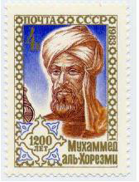
Algorithm: A brief History
The word algorithm comes from the name of Persian author, Abu Ja’far Mohammed ibn Musa al Khowarizmi (c. 825 A.D.), who wrote a textbook on mathematics.
The book was translated into Latin in the 12th century under the title Algoritmi de numero Indorum. This title means "Algoritmi on the numbers of the Indians", where "Algoritmi" was the translator's Latinization of Al-Khwarizmi's name.
Many centuries later, decimal system was adopted in Europe, and the procedures in Al Khwarizmi’s book were named after him as “Algorithms”.
Notes:
algorism

Slide 9
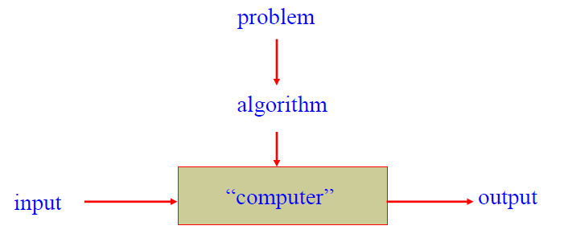
What is an Algorithm?
An algorithm is a sequence of unambiguous instructions for solving a computational problem i.e., for obtaining a required output for any legitimate input in a finite amount of time.
It is any well defined computational procedure that takes some value or set of values as input and produces some value, or set of values as output

Slide 10
Algorithm & its Properties
More precisely, An algorithm is a finite set of instructions that accomplishes a particular task.
Algorithm must satisfy the following properties:
Input
  Valid inputs must be clearly specified.
Output
  can be proved to produce the correct output given a valid input.
Finiteness
  terminates after a finite number of steps
Definiteness
  Each instruction must be clear and unambiguously specified
Effectiveness
  Every instruction must be sufficiently simple and basic.

Slide 11
Examples of Algorithms – Computing the Greatest Common Divisor of Two Integers
Problem: Find gcd (m,n), the greatest common divisor of two nonnegative, not both zero integers m and n
//First try –School level algorithm:
Step1: factorize m.( m 🡨 m1*m2*m3…)
Step2: factorize n. (n 🡨 n1*n2*…)
Step 3: Identify common factors , multiply and return.

Slide 12
Pseudocode of Euclid’s Algorithm
Algorithm : Euclid (m, n)
//Computes gcd(m, n) by Euclid’s algorithm
//Input: Two non negative, not-both-zero integers m and n
//Output: Greatest common divisor of m and n gcd(m, n) = gcd(n, m mod n)
While (m does not divide n) do
  r 🡨 n mod m
  n 🡨 m
    m 🡨 r
return m
Questions:
Finiteness: how do we know that Euclid’s algorithm actually comes to a stop?
Definiteness: non-ambiguity
Effectiveness: effectively computable.
Which algorithm is faster, the Euclid’s or previous one?

Slide 13
Example of Euclid’s Algorithm
Simple Algorithm
m = 36, n = 48
m = 2 * 2 * 3 * 3
n = 2 * 2 * 2 * 2 * 3
Common factors
2, 2, 3
GCD = 12
9 divisions
Euclid Algorithm
36 divides 48
r = 48 mod 36
n = 36
m = 12
Return 12
2 divisions
Another example:
  m = 434 and n = 966

Slide 14
Fundamentals of Algorithmic Problem Solving
Understanding the problem
  Asking questions, do a few examples by hand, think about special cases, etc.
Deciding on
  Exact vs. approximate problem solving
Appropriate data structure
Design an algorithm
Proving correctness
Analyzing an algorithm
  Time efficiency : how fast the algorithm runs
  Space efficiency: how much extra memory the algorithm needs.
Coding an algorithm

Slide 15
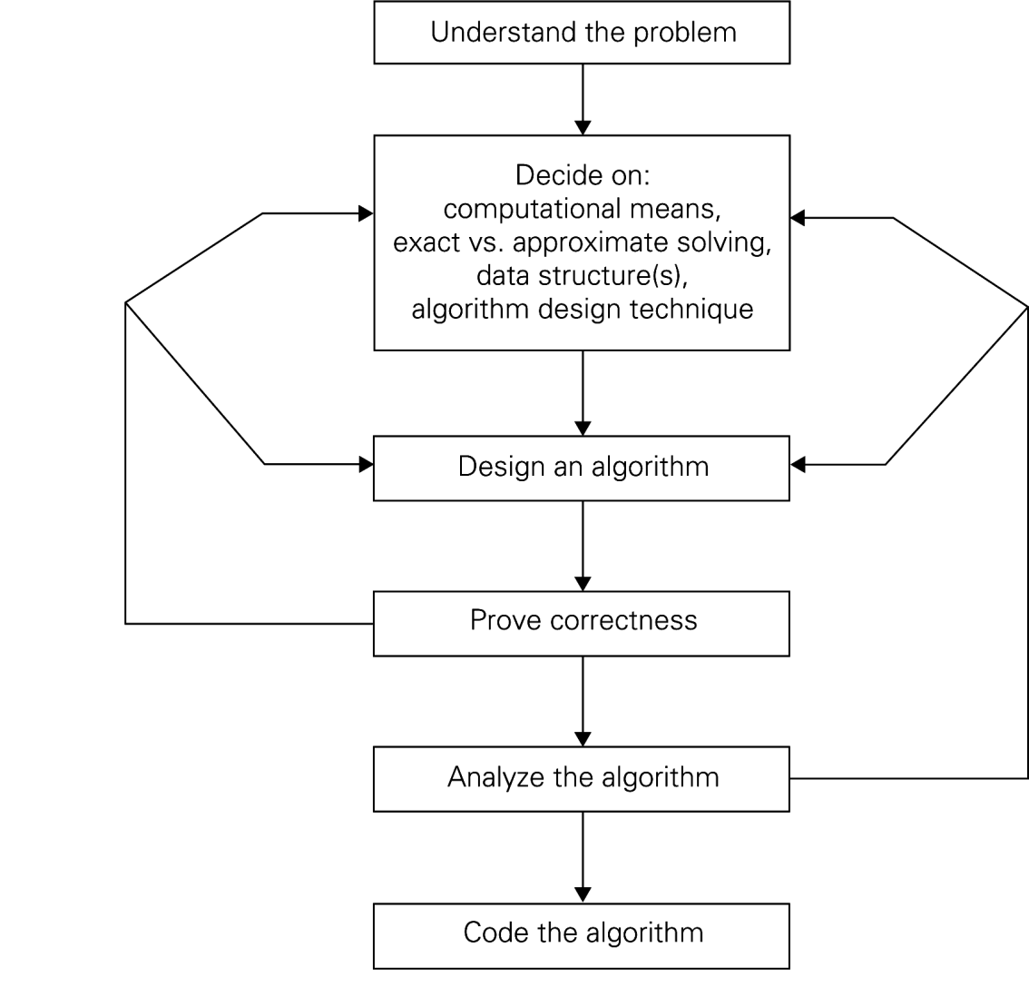
Algorithm Design and Analysis Process

Slide 16
Algorithms as a Technology
Even if computers were infinitely fast and memory was plentiful and free
  Study of algorithms still important – still need to establish algorithm correctness
  Since time and space resources are infinitely fast, any correct algorithm for solving a problem would do.
Real-world computers may be fast but not infinitely fast.
Memory is cheap but not free
Hence Computing time is bounded resource and so need space in memory.
We should use resources wisely by efficient algorithm in terms of space and time

Slide 17
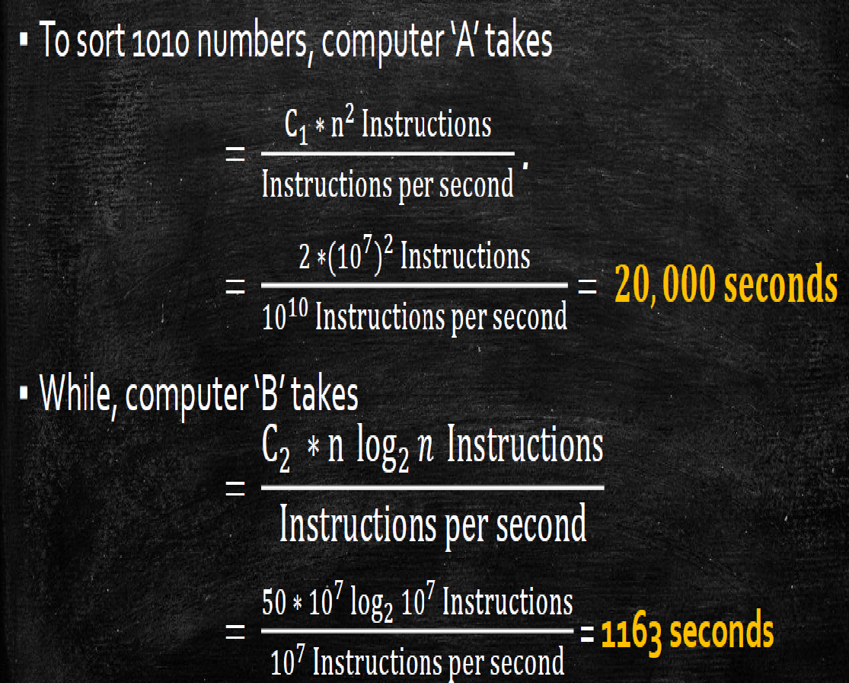
Algorithm Efficiency
Time and space efficiency are the goal
Algorithms often differ dramatically in their efficiency
  Example: Two sorting algorithms
    INSERTION-SORT – time efficiency is c₁n²
    MERGE-SORT – time efficiency is c₁nlogn
  For which problem instances would one algorithm be preferable to the other?
  For example,
  A faster computer ‘A’ (10¹⁰ instructions/sec) running insertion sort against a slower computer ‘B’ (10⁷instructions/sec) running merge sort. Suppose that c1=2，c2=50 and n= 10⁷.
Notes:
C1 and c2 not depend on input size n

Slide 18
Efficiency
Machine A
Insertion- Sort
Machine B
Merge- Sort
Problem Size
n | 2n²/10⁹ | 50nlogn/10⁷
10,000 | 0.20 | 0.66
50,000 | 5.00 | 3.90
100,000 | 20.00 | 8.30
500,000 | 500.00 | 47.33
1,000,000 | 2,000.00 | 99.66
5,000,000 | 50,000.00 | 556.34
10,000,000 | 200,000.00 | 1,162.67
50,000,000 | 5,000,000.00 | 6,393.86

Slide 19
Methods of Specifying an Algorithm
Natural language
  Ambiguous
  Example : “Mike ate the sandwich on a bed.”
Flowchart
  Graphic representations called flowcharts , only if the algorithm is small and simple.
Pseudocode
  A mixture of a natural language and programming language-like structures
  Precise and concise.
Pseudocode in this course
  omits declarations of variables
  use indentation to show the scope of such statements as for, if, and while.
  use 🡨 for assignment

Slide 20
Pseudocode Conventions
Comments begin with // and continue until the end of line.
Blocks are indicated with matching braces :{ and }. A compound statement (i.e., a collection of simple statements) can be represented as as a block. The body of a procedure also forms a block. Statements are delimited by;
Assignment of values to variables is done using the assignment statement
〈variable〉≔〈expression〉;
There are two Boolean values true and false. In order to produce these values,
  Logical operators : and, or, and not
  Relational operators<, ≤, =, ≠, ≥, and >
Elements of multidimensional arrays are accessed using [ and ]. Ex A[i,j]

Slide 21
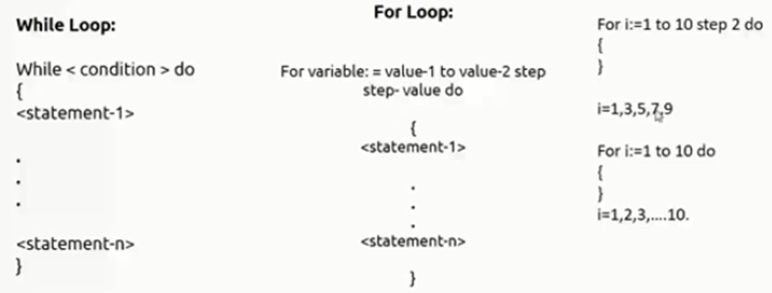
Pseudocode Conventions
Looping statement can be employed as follows :
( while, for , repeat-until )
A conditional statement has the following forms:
    If 〈condition〉 then 〈statement〉
    If 〈condition〉 then 〈statement 1〉 else 〈statement 2〉
We also employ the following case statement:
case
{
: 〈condition 1〉: 〈statement 1〉
.
: 〈condition n〉: 〈statement n〉
: else: 〈statement n + 1〉
}

Slide 22
Pseudocode Conventions
REF BOOK SAHNI
Input and output are done using the instructions read and write. No format is used to specify the size of input or output quantities.
An algorithm consists of a heading and a body. The heading takes the form
Algorithm Name (〈parameter list〉)
{
// body
}
Example : Algorithm to find and return the maximum of n given numbers:
Algorithm Max (A, n)
// A is an array of size n.
{
Result ≔A[1];
For i ≔2 to n do
If A[i] > Result then Result ≔A[i];
Return Result;
}

Slide 23
Analysis of Algorithms
Two main issues related to algorithms
How to design algorithms
How to analyze algorithm efficiency
Analysis of Algorithms
How good is the algorithm?
  time efficiency
  space efficiency
Does there exist a better algorithm?
  lower bounds
  optimality

Slide 24
Common Rates of Growth
Let n be the size of input to an algorithm, and k some constant. The following are common rates of growth.
Constant: Θ(k), for example Θ(1)
Linear: Θ(n)
Logarithmic: Θ(log_{k} n)
Linear : n Θ(n) or n log n: Θ(n log_{k} n)
Quadratic: Θ(n² )
Polynomial: Θ(n^{k} )
Exponential: Θ(k^{n})

Slide 25
Why Analyse?
Practical reasons:
  Resources are scarce
  Greed to do more with less
  Avoid performance bugs
Core Issues:
Predict performance
  How much time does binary search take?
Compare algorithms
  How quick is Quicksort?
Provide guarantees
  Size not with standing, Red-Black tree inserts in O(log n)
Understand theoretical basis
  Sorting by comparison cannot do better than (n log n)

Slide 26
What to analyse?
REF BOOK: NPTEL
REF BOOK: NPTEL
Core Issue: Cannot control what we cannot measure
Time
  The time complexity, T(n), taken by a program P is the sum of the running times for each statement executed
  Space
  The space complexity of a program is the amount of memory that it needs to run to completion
Examples : Sum of Natural Numbers
    // Sum of Natural Numbers
    Algorithm sum (a, n)
    {
    s := 0 ;
    For i := 1 to n do
    s := s + a[i];
    return s;
    }
Time T(n) = n (additions)
Space S(n) = 2 (n, s)
Notes:
Whatever can be measured that we want to analyze

Slide 27
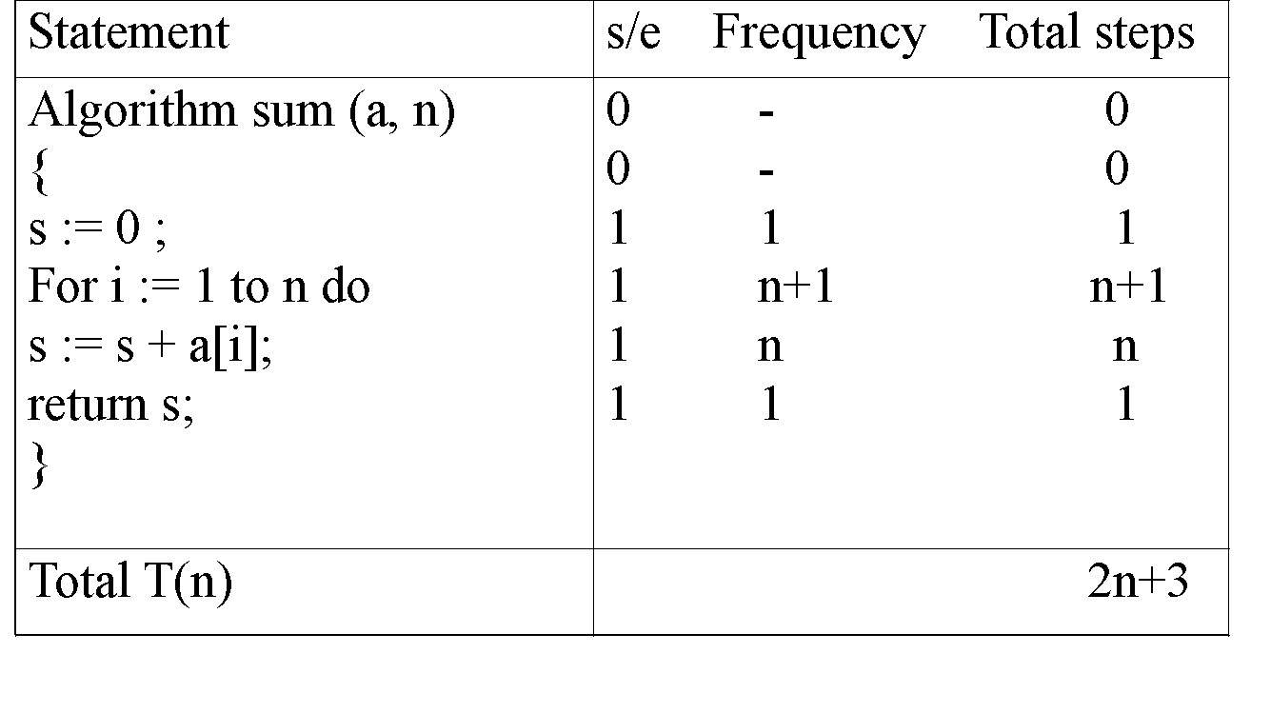
Tabular Method
REF BOOK SAHNI
Iterative function to sum a list of numbers (steps/execution )
Machine Model: Random Access Machine (RAM) Computing Model
  Input data & size
  Operations
  Intermediate Stages
  Output data & size

Slide 28
Asymptotic Analysis
Core Idea: Cannot compare actual times; hence compare Growth or how time increases with input
O notation (“Big Oh”)
Ω notation (Omega)
Θ notation (Theta)
o notation (Little oh)
ω notation (Little omega)

Slide 29
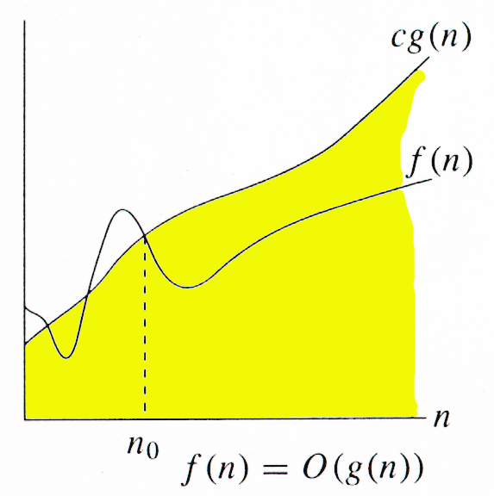
ASYMPTOTICS NOTATIONS
O-notation (Big Oh)
Asymptotic Upper Bound
For a given function g(n), we denote O(g(n)) as the set of
functions:
O(g(n)) = { f(n)| there exists positive constants c and n0
such that 0 ≤ f(n) ≤ c g(n) for all n ≥ n0 }
It is used to represent the worst case growth of an algorithm
in time or a data structure in space when they are
dependent on n, where n is big enough
Example :

Slide 30
Big Oh - Example
f(n) = n²+ 5n = O(n2)
g(n) = n² ……… c = 2
  n n²+ 5n 2n²
1 6 2
2 14 8
5 50 50
f(n) <= c g(n) for all n> = n₀ where c=2 & n₀ =5

Slide 31
Big Oh - Example
Let f(N) = 2N². Then
  f(N) = O(N⁴) (loose bound)
  f(N) = O(N³) (loose bound)
  f(N) = O(N²) (It is the best answer and the bound is asymptotically tight.)
O(N²): reads “order N-squared” or “Big-Oh N-squared”.

Slide 32
Big Oh - Example
Prove that if T(n) = 15n³ + n² + 4, T(n) = O(n³).
Proof.
Let c = 20 and n₀ = 1.
Must show that 0 ≤ f (n) and f (n) ≤ cg(n).
0≤15n³ + n² + 4 for all n ≥ n₀ = 1.
f (n) = 15n³ + n² + 4 ≤ 20n³ (20g(n) = cg(n))
As per defination of Big O, hence T(n) = O(n³)

Slide 33
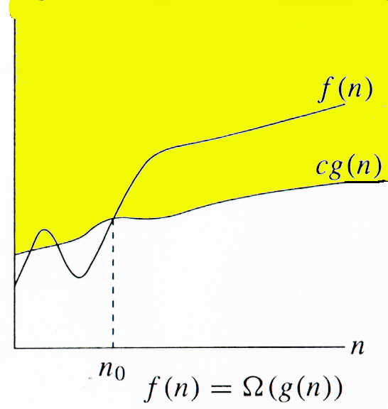
ASYMPTOTICS NOTATIONS
Ω-notation
Asymptotic lower bound
Ω (g(n)) represents a set of functions such that:
Ω(g(n)) = {f(n): there exist positive
    constants c and n0 such that
    0 ≤ c g(n) ≤ f(n) for all n≥ n0}

Slide 34
Big Omega - Example
Example 1 :
f(n) = n²+ 5n
g(n) = n² ……… c = 1
  n n²+ 5n c*n²
¹ ⁵ ¹
2 14 4
5 50 25
f(n) >= c g(n) for all n> = n₀ where c=1 & n₀ =1
Example 1 :
Prove that if T(n) = 15n³ + n² + 4, T(n) = Ω (n³).
Proof.
Let c = 15 and n₀ = 1.
Must show that 0 ≤ cg(n) and cg(n) ≤ f (n).
0 ≤ 15n³ for all n ≥ n₀ = 1.
cg(n) = 15n³ ≤ 15n³ + n² + 4 = f (n)

Slide 35
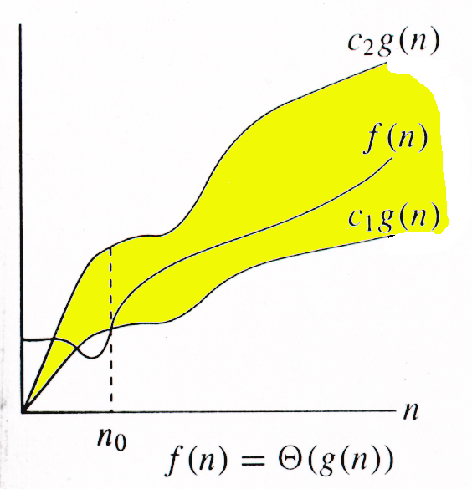
ASYMPTOTICS NOTATIONS
Θ-notation
Asymptotic tight bound
Θ (g(n)) represents a set of functions such that:
Θ (g(n)) = {f(n): there exist positive
    constants c1, c2, and n0such
    that 0 ≤ c1g(n) ≤ f(n) ≤ c2g(n)
    for all n≥ n0 }

Slide 36
Theta Example
f(N) = Θ(g(N)) iff f(N) = O(g(N)) and f(N) = Ω(g(N))
It can be read as “f(N) has order exactly g(N)”.
The growth rate of f(N) equals the growth rate of g(N). The
growth rate of f(N) is the same as the growth rate of g(N)
for large N.
Theta means the bound is the tightest possible.
If T(N) is a polynomial of degree k, T(N) = Θ(N^{k}).
For logarithmic functions, T(log_{m} N) = Θ(log N).

Slide 37
Asymptotic Notations
It is a way to compare “sizes” of functions
O-notation ------------------Less than equal to (“≤”)
Θ-notation ------------------Equal to (“=“)
Ω-notation ------------------Greater than equal to (“≥”)
O ≈ ≤
Ω ≈ ≥
Θ ≈ =

Slide 38
Examples On Asymptotic Notations
Explain How is f(x) = 4n^2 – 5n + 3 is O(n^2)
Show that
30n+8 is O(n)
100n + 5 ≠ Ω(n²)
5n² = Ω(n)
100n + 5 = O(n²)
n²/2 –n/2 = Θ(n²)

Slide 39
Algorithm Design Techniques/Strategies
Brute force
Divide and conquer
Space and time tradeoffs
Greedy approach
Dynamic programming
Backtracking
Branch and bound

Slide 40
Methods for Solving recurrences
Substitution Method
  We guess a bound and then use mathematical induction to prove our guess correct.
Master Method

Slide 41
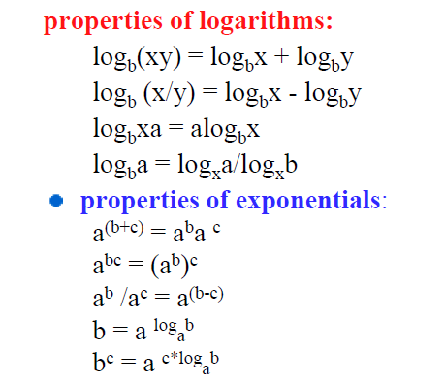
Math You need to Review

Slide 42
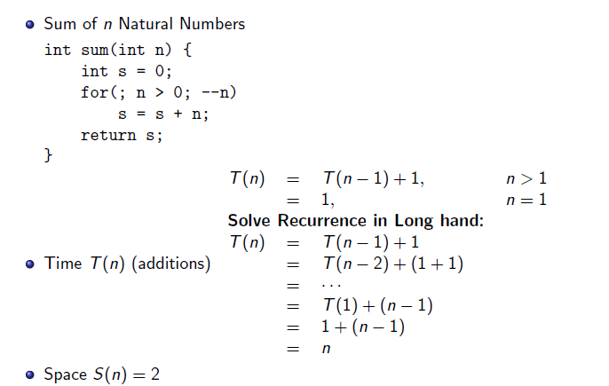
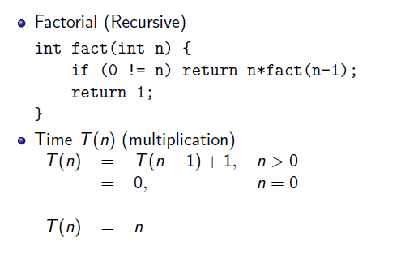
Substitution Method

Slide 43
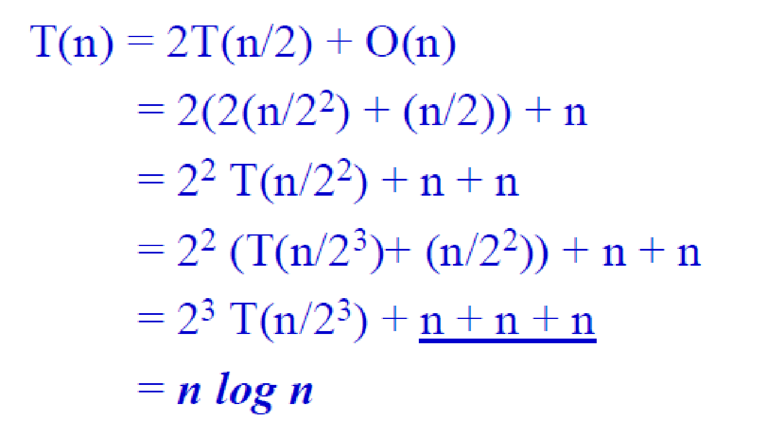
Quick Sort Recurrence Relation

Slide 44
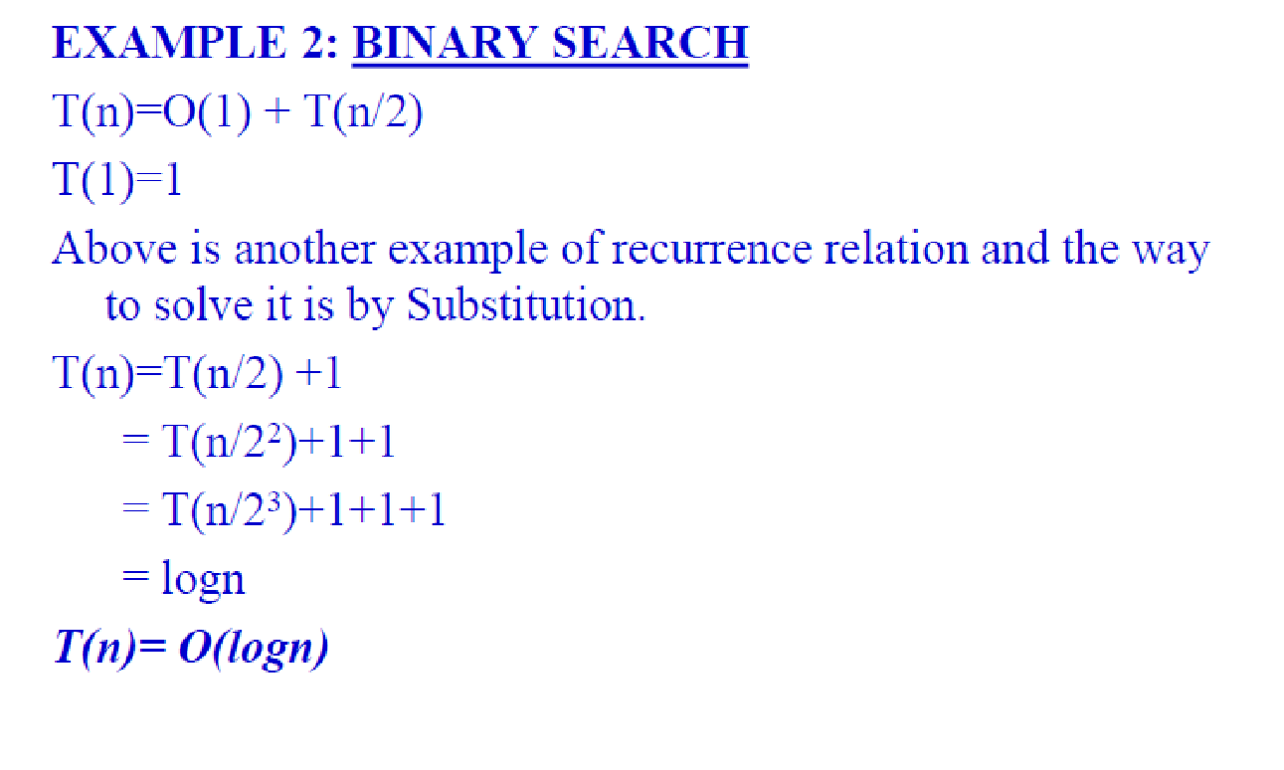
Binary Search Recurrence Relation

Slide 45
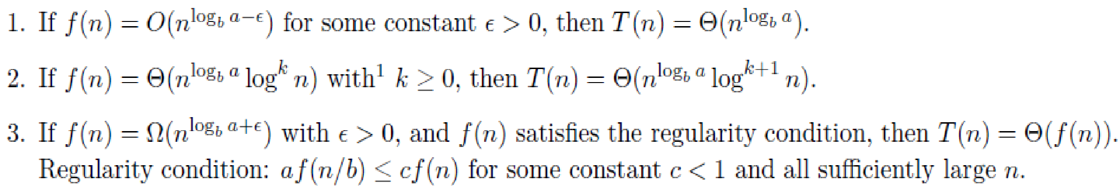
Master Theorem
Master method provides a “cookbook” method for solving recurrences of the following form
T(n) = a T(n/b) + f(n)
where a ≥ 1, b > 1. If f(n) is asymptotically positive function. T(n) has following asymptotic bounds:
There are 3 cases:

Slide 46
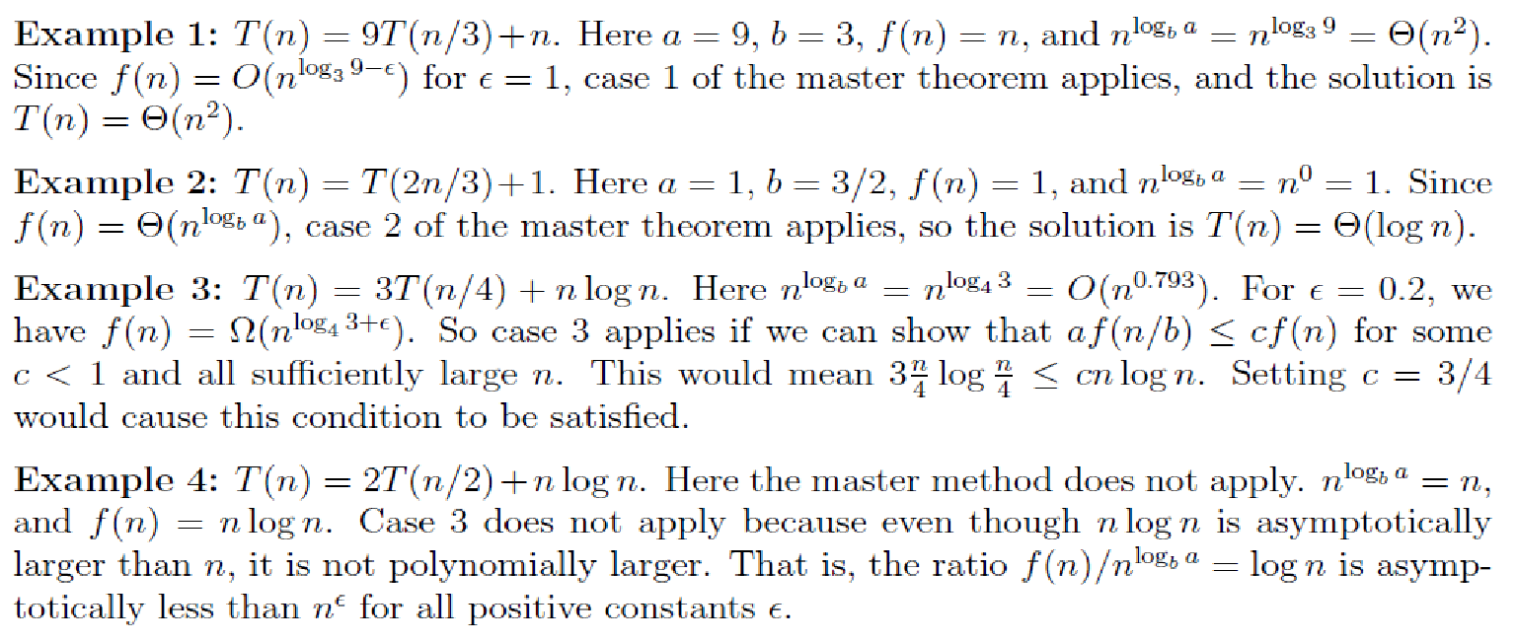
Example of Master Method
To use the master theorem, we simply plug the numbers into the formula

Slide 47
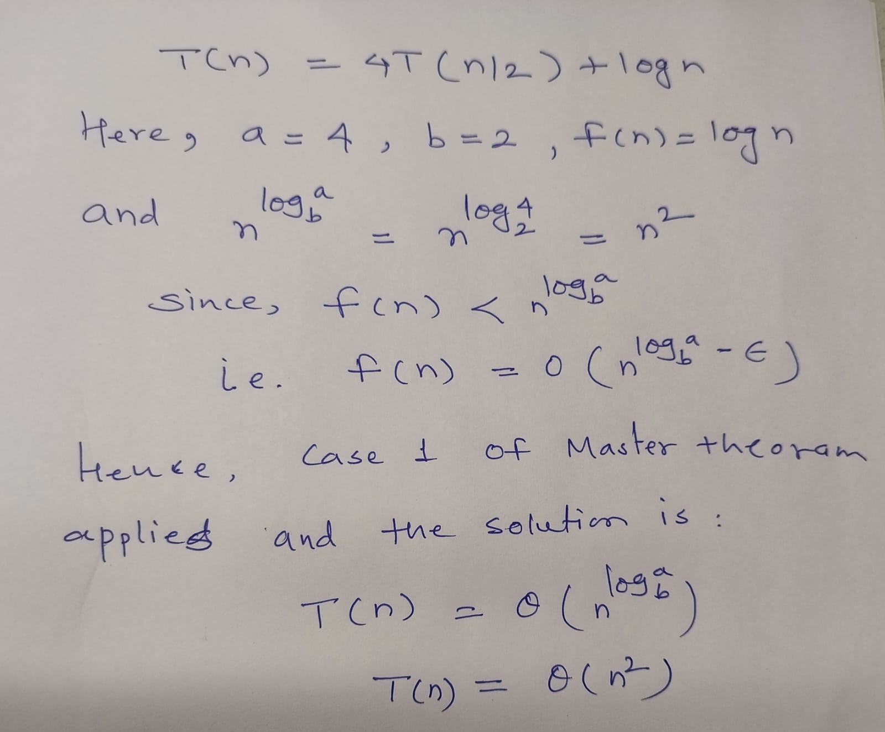
Example of Master Method
Case 1

Slide 48
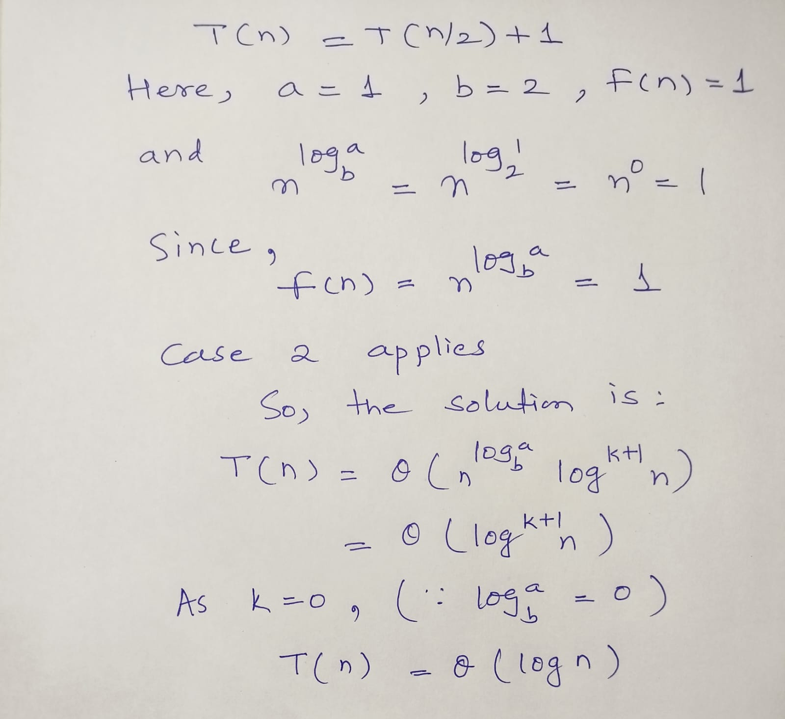
Example of Master Method
Case 2

Slide 49
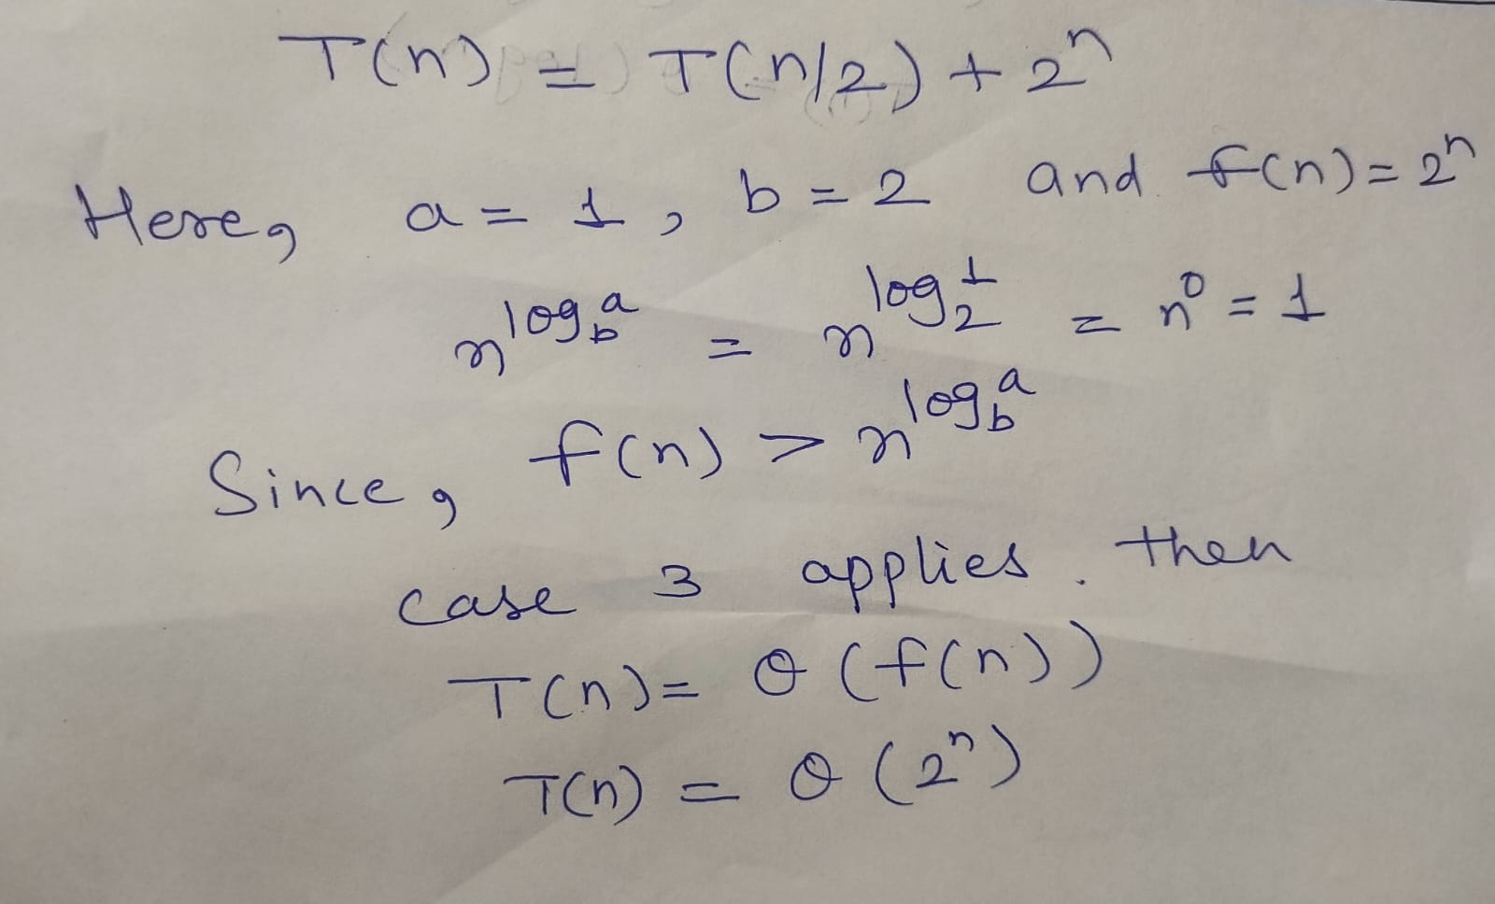
Example of Master Method
Case 3

Slide 50

Searching
Searching is the process of determining whether or not a given value exists in a data structure or a storage media.
Two searching methods are: linear search and binary search.
The linear (or sequential) search algorithm on an array is:
  1. Sequentially scan the array, comparing each array item with the searched value.
  2. If a match is found; return the index of the matched element; otherwise return –1.

Slide 51
Searching
When we maintain a collection of data, one of the operations we need is a search routine to locate desired data quickly.
Here’s the problem statement:
Given a value X, return the index of X in the array, if such X exists. Otherwise, return NOT_FOUND (-1). We assume there are no duplicate entries in the array.
We will count the number of comparisons in the algorithms
- The ideal searching algorithm will make the least possible number of comparisons to locate the desired data.
– Two separate performance analyses are normally done, one for
successful search and another for unsuccessful search.

Slide 52
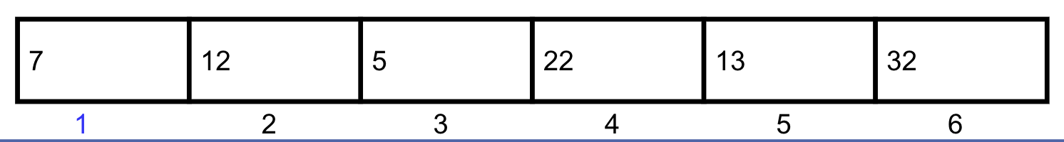
Linear Search Algorithm
Algorithm Search(array,target,size)
{
for i=1 to size do
{
if(array[i] = target)
{
print(“Target data found”)
break;
}
}
if(i >=size)
print(“Target not found”)
}
Scan the array

Slide 53
Algorithm Search(array,target,size)
{
for i=1 to size do
{
if(array[i] = target)
{
print(“Target data found”)
break;
}
}
if(i>size)
print(“Target not found”)
}
array
7
12
5
22
13
32
target = 13
1
2
3
4
5
6

Slide 54
Algorithm Search(array,target,size)
{
for i=1 to size do
{
if(array[i] = target)
{
print(“Target data found”)
break;
}
}
if(i>=size)
print(“Target not found”)
}
array
7
12
5
22
13
32
target = 13
1
2
3
4
5
6

Slide 55
Algorithm Search(array,target)
{
for i=1 to size do
{
if(array[i] = target)
{
print(“Target data found”)
break;
}
}
if(i>=size)
print(“Target not found”)
}
array
7
12
5
22
13
32
target = 13
1
2
3
4
5
6

Slide 56
Algorithm Search(array,target,size)
{
for i=1 to size do
{
if(array[i] = target)
{
print(“Target data found”)
break;
}
}
if(i>=size)
print(“Target not found”)
}
array
7
12
5
22
13
32
target = 13
1
2
3
4
5
6

Slide 57
Algorithm Search(array,target,size)
{
for i=1 to size do
{
if(array[i] = target)
{
print(“Target data found”)
break;
}
}
if(i>=size)
print(“Target not found”)
}
array
7
12
5
22
13
32
target = 13
1
2
3
4
5
6

Slide 58
Algorithm Search(array,target,size)
{
for i=1 to size do
{
if(array[i] = target)
{
print(“Target data found”)
break;
}
}
if(i>=size)
print(“Target not found”)
}
array
7
12
5
22
13
32
target = 13
1
2
3
4
5
6

Slide 59
Algorithm Search(array,target,size)
{
for i=1 to size do
{
if(array[i] = target)
{
print(“Target data found”)
break;
}
}
if(i>=size)
print(“Target not found”)
}
array
7
12
5
22
13
32
target = 13
1
2
3
4
5
6

Slide 60
Algorithm Search(array,target,size)
{
for i=1 to size do
{
if(array[i] = target)
{
print(“Target data found”)
break;
}
}
if(i>=size)
print(“Target not found”)
}
Target data found
array
7
12
5
22
13
32
target = 13
1
2
3
4
5
6

Slide 61
Algorithm Search(array,target,size)
{
for i=1 to size do
{
if(array[i] = target)
{
print(“Target data found”)
break
}
}
if(i>=size)
print(“Target not found”)
}
array
7
12
5
22
13
32
target = 13
1
2
3
4
5
6

Slide 62
Linear Search Analysis: Best Case
Algorithm Search(array,target,size)
{
for i=1 to size do
{
if(array[i] = target)
{
print(“Target data found”)
break;
}
}
if(i>=size)
print(“Target not found”)
}
Best Case:
1 comparison
Best Case: match with the first item
7
12
5
22
13
32
target = 7

Slide 63
Linear Search Analysis: Worst Case
Algorithm Search(array,target,size)
{
for i=1 to size do
{
if(array[i] = target)
{
print(“Target data found”)
break;
}
}
if(i>=size)
print(“Target not found”)
}
Worst Case:
N comparisons
Worst Case: match with the last item (or no match)
7
12
5
22
13
32
target = 32

Slide 64
Linear Search Animation
Linear Search Animation :
https://yongdanielliang.github.io/animation/web/LinearSearchNew.html

Slide 65
Sequential search
int seqsearch(int key)
{
for i= 0 to n
{
if(key==a[i])
{
pos=i;
flag=1;
break;
}
}
if(flag==1)
return pos;
else
return -1;
}
Using Class
class search
{
int a[20],n;
public:
int seqsearch(int);
void accept();
void display();
};

Slide 66
Linear Search Performance
We analyze the successful and unsuccessful searches separately.
We count how many times the search value is compared against the array elements.
Successful Search
– Best Case – 1 comparison
– Worst Case – N comparisons (N – array size)
Unsuccessful Search
– Best Case = Worst Case – N comparisons

Slide 67
Binary Search
If the array is sorted, then we can apply the binary search technique.
The basic idea is straightforward. First search the value in the middle position.
If X is less than this value, then search the middle of the left half next.
If X is greater than this value, then search the middle of the right half next.

Slide 68
Binary Search
Binary search. Given value and sorted array a[], find index i
such that a[i] = value, or report that no such index exists.
Invariant. Algorithm maintains a[lo] ≤ value ≤ a[hi].
Ex. Binary search for 33.
6
13
14
25
33
43
51
53
64
72
84
93
95
96
97
0
1
2
3
4
5
6
7
8
9
10
11
12
13
14
lo
hi

Slide 69
Binary Search
Binary search. Given value and sorted array a[], find index i
such that a[i] = value, or report that no such index exists.
Invariant. Algorithm maintains a[lo] ≤ value ≤ a[hi].
Ex. Binary search for 33.
6
13
14
25
33
43
51
53
64
72
84
93
95
96
97
0
1
2
3
4
5
6
7
8
9
10
11
12
13
14
lo
mid
hi

Slide 70
Binary Search
Binary search. Given value and sorted array a[], find index i
such that a[i] = value, or report that no such index exists.
Invariant. Algorithm maintains a[lo] ≤ value ≤ a[hi].
Ex. Binary search for 33.
6
13
14
25
33
43
51
53
64
72
84
93
95
96
97
0
1
2
3
4
5
6
7
8
9
10
11
12
13
14
lo
hi

Slide 71
Binary Search
Binary search. Given value and sorted array a[], find index i
such that a[i] = value, or report that no such index exists.
Invariant. Algorithm maintains a[lo] ≤ value ≤ a[hi].
Ex. Binary search for 33.
6
13
14
25
33
43
51
53
64
72
84
93
95
96
97
0
1
2
3
4
5
6
7
8
9
10
11
12
13
14
lo
mid
hi

Slide 72
Binary Search
Binary search. Given value and sorted array a[], find index i
such that a[i] = value, or report that no such index exists.
Invariant. Algorithm maintains a[lo] ≤ value ≤ a[hi].
Ex. Binary search for 33.
6
13
14
25
33
43
51
53
64
72
84
93
95
96
97
0
1
2
3
4
5
6
7
8
9
10
11
12
13
14
lo
hi

Slide 73
Binary Search
Binary search. Given value and sorted array a[], find index i
such that a[i] = value, or report that no such index exists.
Invariant. Algorithm maintains a[lo] ≤ value ≤ a[hi].
Ex. Binary search for 33.
6
13
14
25
33
43
51
53
64
72
84
93
95
96
97
0
1
2
3
4
5
6
7
8
9
10
11
12
13
14
lo
mid
hi

Slide 74
Binary Search
Binary search. Given value and sorted array a[], find index i
such that a[i] = value, or report that no such index exists.
Invariant. Algorithm maintains a[lo] ≤ value ≤ a[hi].
Ex. Binary search for 33.
6
13
14
25
33
43
51
53
64
72
84
93
95
96
97
0
1
2
3
4
5
6
7
8
9
10
11
12
13
14
lo
hi

Slide 75
Binary Search
Binary search. Given value and sorted array a[], find index i
such that a[i] = value, or report that no such index exists.
Invariant. Algorithm maintains a[lo] ≤ value ≤ a[hi].
Ex. Binary search for 33.
6
13
14
25
33
43
51
53
64
72
84
93
95
96
97
0
1
2
3
4
5
6
7
8
9
10
11
12
13
14
lo
hi
mid

Slide 76
Binary Search
Binary search. Given value and sorted array a[], find index i
such that a[i] = value, or report that no such index exists.
Invariant. Algorithm maintains a[lo] ≤ value ≤ a[hi].
Ex. Binary search for 33.
6
13
14
25
33
43
51
53
64
72
84
93
95
96
97
0
1
2
3
4
5
6
7
8
9
10
11
12
13
14
lo
hi
mid

Slide 77
Example: Binary Search
Searching for an element k in a sorted array A with n elements
Idea:
  Choose the middle element A[n/2]
  If k == A[n/2], we are done
  If k < A[n/2], search for k between A[0] and A[n/2 -1]
  If k > A[n/2], search for k between A[n/2 + 1] and A[n-1]
  Repeat until either k is found, or no more elements to search
Requires less number of comparisons than linear search in the worst case (log₂n instead of n)

Slide 78
Linear Search and Binary search Animation
Linear Search Animation :
https://www.cs.usfca.edu/~galles/visualization/Search.html

Slide 79
Time Complexity of Binary Search
The maximum no of elements after 1 comparison =n/2
The maximum number of elements after 2 comparisons =n/2²
The maximum number of elements after h comparisons =n/2^{h}
^{For} the lowest value of h elements 1 left
n/2^{h=1 or} 2^{h=n h=log}₂^{(n)=O(log}₂ ^{n)}

Slide 80
Binary Search Algorithm
Algorithm binary_search(a[], low, high, key) {
while(low<=high) {
mid=(low+high)/2;
if(a[mid]==key) {
flag=1;
return flag; } //end if
else if (key<a[mid])
high=mid-1;
else
low=mid+1;
} //end while
If (flag==0)
{ return flag;}
}//end binary_search
Look for 42
1 7 9 12 33 42 59 76 81 84 91 92 93 99
0 | 1 | 2 | 3 | 4 | 5 | 6 | 7 | 8 | 9 | 10 | 11 | 12 | 13

Slide 81
Binary search(recursive)
Algorithm binary_search(a[], low, high, key)
{
if(low<=high) {
mid=(low+high)/2;
if(a[mid]==key)
return mid;
else if (key<a[mid])
return binary_search(a,low,mid-1,key);
else
return binary_search(a,mid+1,high,key);}
return -1;
}

Slide 82
FAQ
Select the data structures that you have seen previously, and discuss its strengths and limitations
What is time complexity?
What is linear search?
What are the limitations of linear search?
What are the advantages of binary search over linear search?

Slide 83
References
Thomas H Cormen and Charles E.L Leiserson, "Introduction to Algorithm" Third Edition, PHI
2 Horowitz, Sahni & Rajasekaran, "Fundamentals of Computer Algorithms", 2ND
Edition. University Press.

